Slide 1
NAME – HARSH JHA ROLL NO – 22020107027 SUBJECT – MINOR PROJECT PROJECT - CAFÉ MANAGEMENT SYSTEM
SUBMITTED TO : VIPIN RATHI SIR

Slide 2
CONTENT:
DEMO
FEATURES
LANGUAGE USED
HOW TO USE.

Slide 3
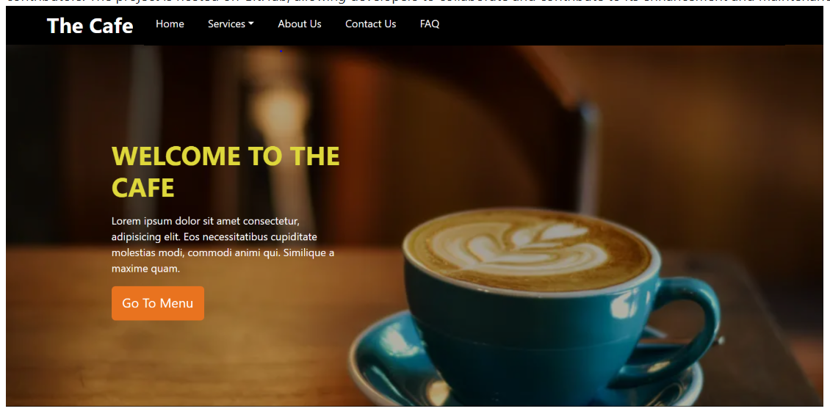
The "Cafe Management" project is an open-source web application designed to streamline the operations of a café or a coffee shop. An online portal for cafe for ordering coffee or snacks. It is developed using HTML, CSS, and JavaScript, making it easily accessible and modifiable for contributors. The project is hosted on GitHub, allowing developers to collaborate and contribute to its enhancement and maintenance

Slide 4
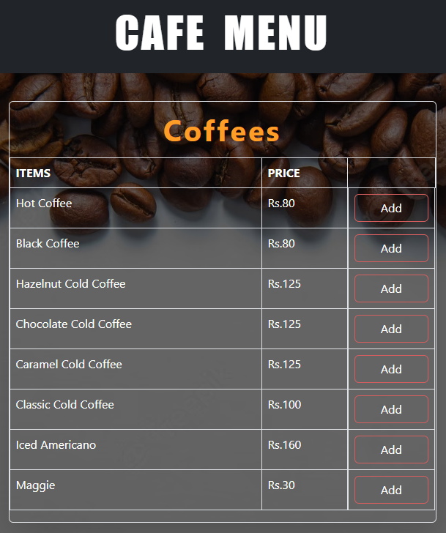
FEATURES:
Menu Display: The application showcases the café's menu items with detailed descriptions, prices, and images for each item such as coffees, pastries, sandwiches, and other offerings.
Ordering System: Users can select and add multiple items to their cart, enabling them to place and modify their orders as needed. The system allows customization options for various items (e.g., choosing coffee size, milk preference, etc.).
Contact Information: Users can directly contact the shop via the Contact Us form, allowing a seamless connection.
FAQs: There are pre-answered questions mentioned in the FAQ section to provide relevant information to the users. Set of predefined questions have been used.

Slide 5
LANGUAGE USED:
HTML
CSS
Bootstrap
Javascript
JQuer

Slide 6
HOW TO USE:
Visit the website URL: https://open-source-chandigarh.github.io/Cafe-Management/.
Browse menu items with descriptions, images, and prices.
Select an item and customize it.
Add it to the cart.
Repeat for multiple items as needed.
Review the cart before proceeding to checkout.
Proceed to checkout and confirm the order.
Order total calculation.
Confirmation messages.

Slide 7
Thank you

